Slide 1
Cloud Native- Fundamental Project
Vaisala Sivanesakumar

Slide 2
Introduction
My name is Vaisala.
The overall objective of this project is to create a CRUD application with a database, API & A front-end.
I chose to base this project on a bakery.

Slide 3
What will be covered
The planning process
Details about the technologies used
Demo of the application
Finally a summary of the project

Slide 4
Planning
Why Bakery?
Planning tools
Pen and paper to break it down
Jira board
3. How was the planning process?

Slide 5
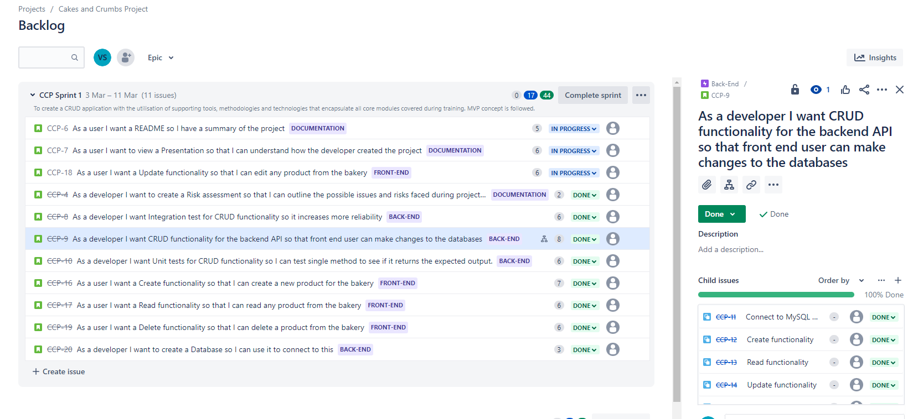
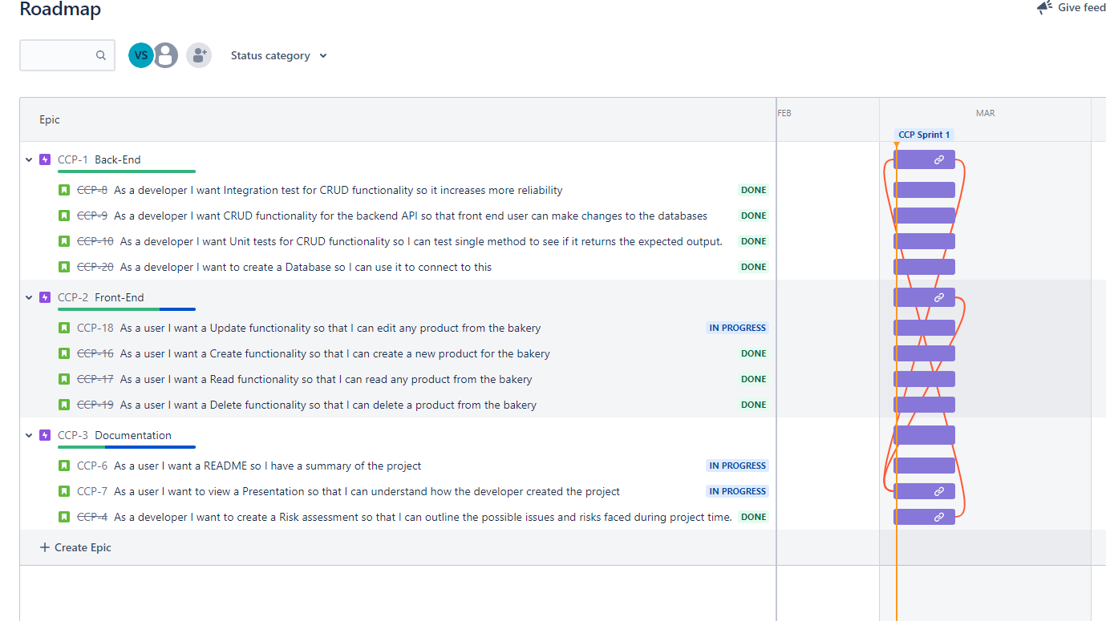

Slide 6
Front-end Technology
HTML
Defines the structure of the Webpage
2. Javascript
Allowed the webpage to interact
Fetch API was used to interact with backend - put/get function

Slide 7
Back-end Technology
MySql
for storing persistent data from the application
Java in a Spring Boot framework
Integration testing -Mockmvc (97.6% coverage)
3. Postman
Sending Http requests to the backend when interacted with frontend.

Slide 8
Application
Demo

Slide 9
Summary
What went well?
Backend went well
2. What didn’t go well?
Creating my Front-end
3. What could I have done differently?
Styled the website more
Filter my bakery list by name or dietary requirement etc
4. Best things learnt?
Front-end skills

Slide 10
Thank you for listening.
Any questions?

